Slide 1

Scala Intro
Twitter: @Scalabcn
Slack: scalabcn.slack.com

Slide 2




Victor Dubé @duferdev
Software engineer
Rodrigo Molina @rgermanm
Software engineer

Slide 3

Notes:
Who have never seen Scala?
Who have seen Scala and did something just for fun? (POC)
Who have worked or actually work with Scala in real production projects?

Slide 4
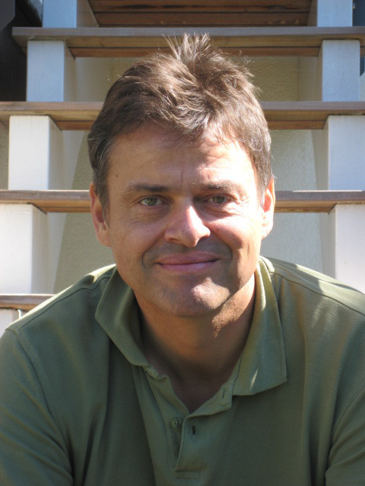
Scala (Wikipedia description)
Born on 2003-2004
Born in EPFL (Switzerland)
Father: Martin Odersky
JVM language...but also Javascript! (scala.js)
Type system: static, strong, inferred
Multi-paradigm: Functional, OO, imperative, concurrent
Current version: 2.12.7

Slide 5
Why Scala?

Slide 6
Why scala?
Successful combination of FP and OOP.
Sophisticated object and type system (flexibility in defining abstractions)
Excellent basis for concurrent, parallel, and distributed computing. (Complex domains!)
Scalable (Small scripts -> Large distributed apps)
Big and rich ecosystem base (Akka, Spark, Scalaz, Cats…)
Compatible with Java
Notes:
Use OOP to model and FP to compute in a natural way
Create great DSLs, easy to use
Less verbosity, expressive
Work in a higher level of abstraction
Work directly with data structures, use FP and immutability
Build systems easy to reason about

Slide 7
The central drive behind Scala is to make life easier and more productive for the developer
--Martin Odersky--

Slide 8
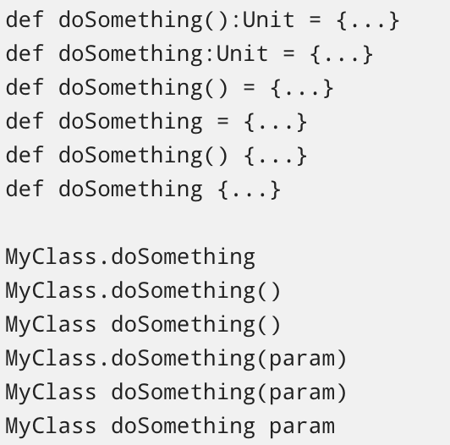
Scala “bad parts”
breaks the “there is only one best way to do something” principle.
High learning curve.
Compiler

Slide 9
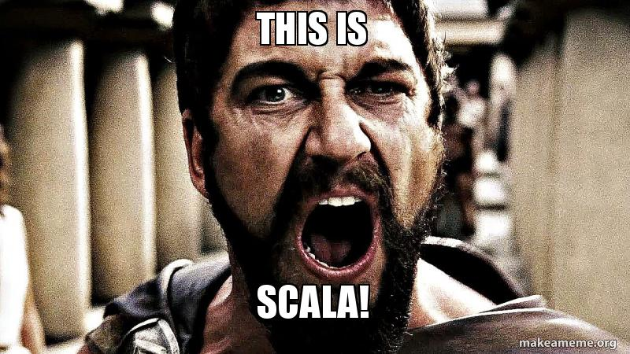

Slide 10
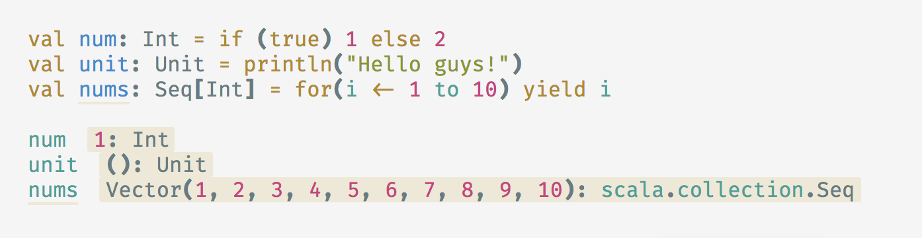
Expression-oriented language
Empower expressions over statements (EOP)
(nearly) everything evaluates to a value (Control structures, side-effects methods...) for composability

Slide 11
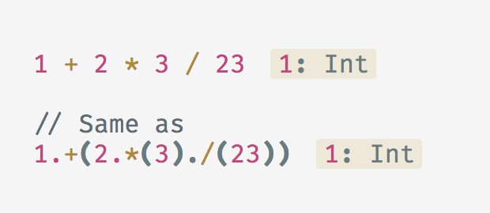
Everything is an object
How??

Slide 12
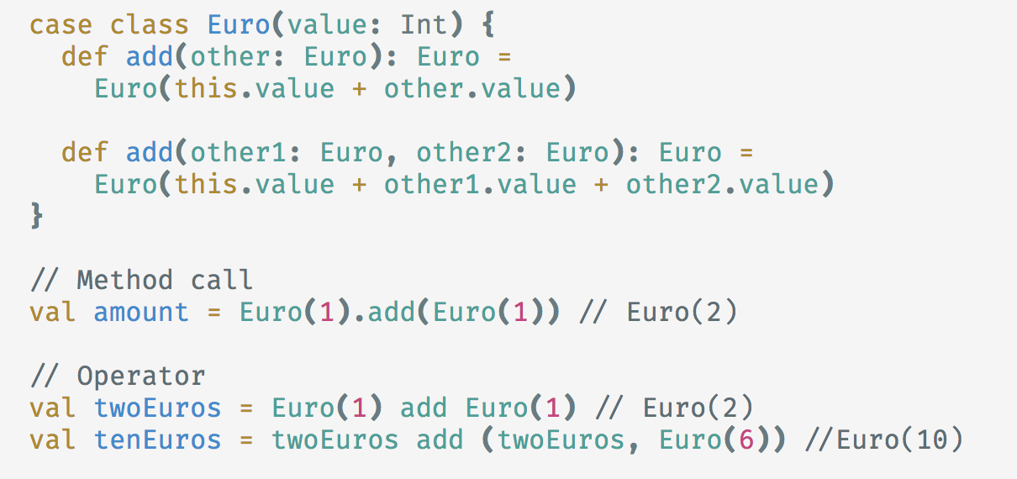
Any method can be an operator

Slide 13
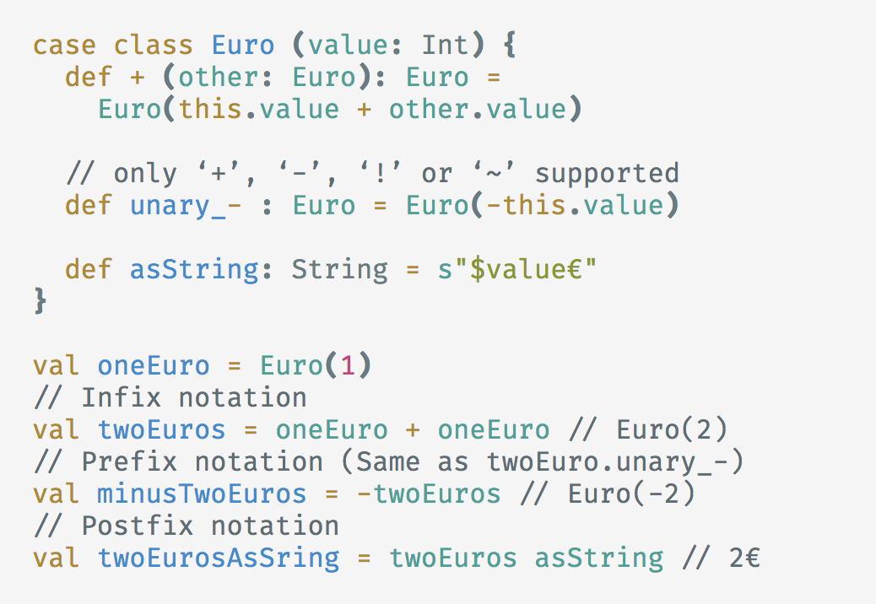
Operator notations

Slide 14
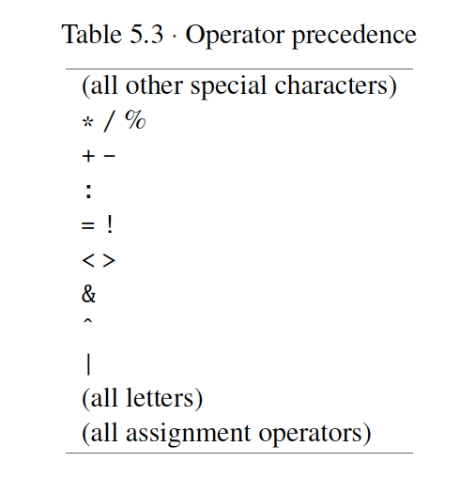
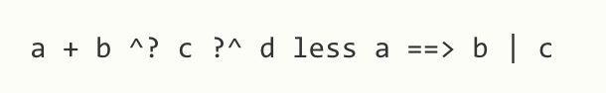
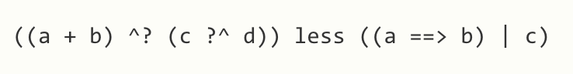
Operator precedence
Scala decides precedence based on the first character of the methods
used in operator notation.
Use parentheses to clarify and override precedence
-> End with =

Slide 15
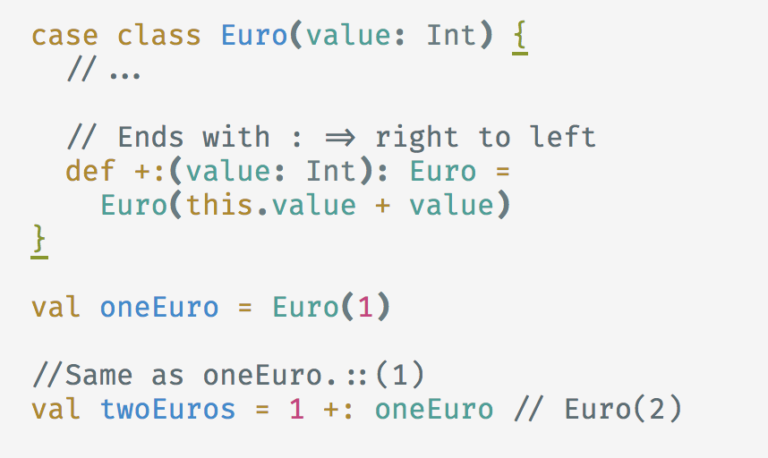
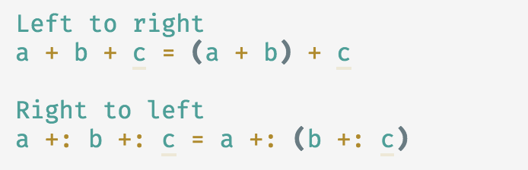
Operator associativity

Slide 16
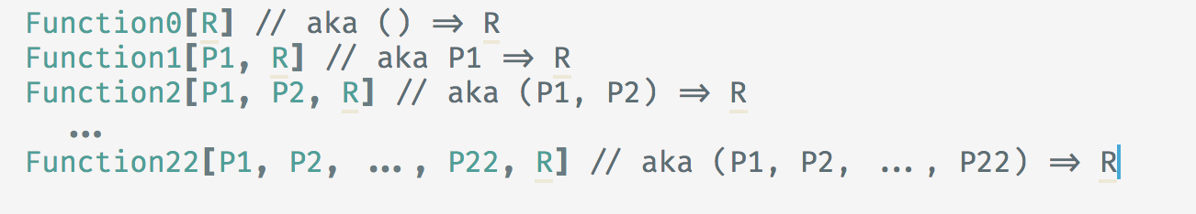
Functions are objects!
and you will learn it in 5 seconds...
Java 8 Style
But why java, why???

Slide 17
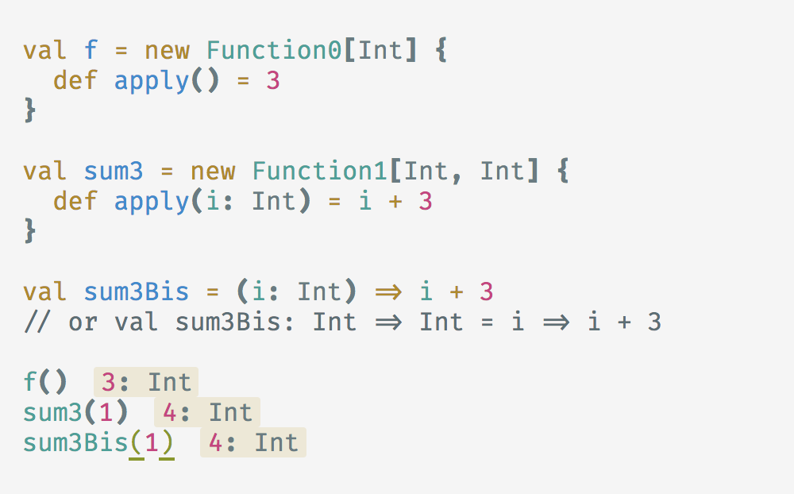
Functions are objects!
so first class citizens...

Slide 18
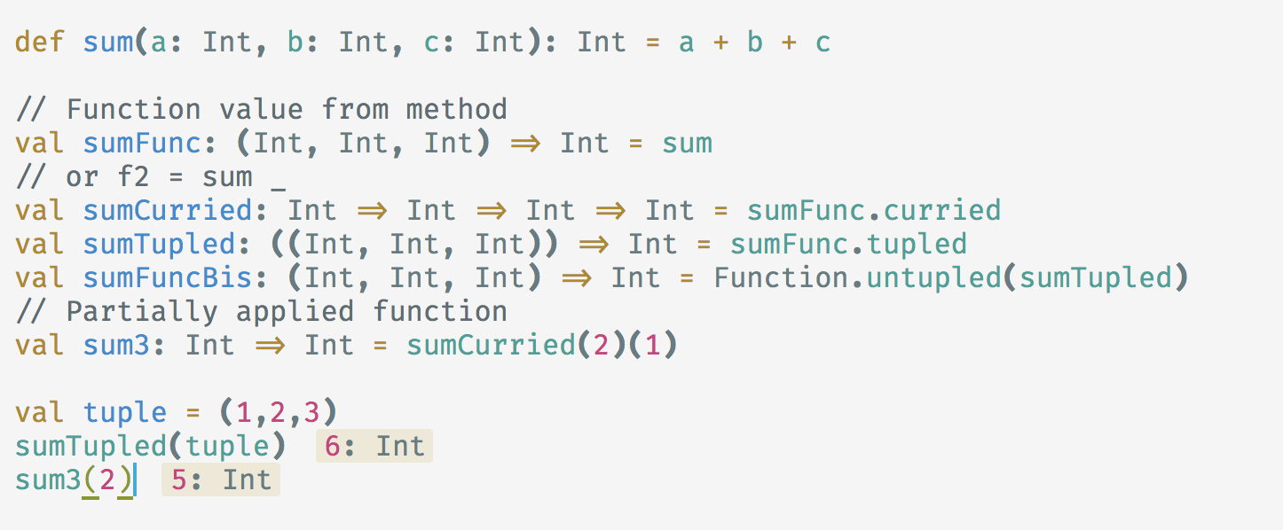
Functions are objects!
so they have cool methods...
Notes:
alguien sabe que es un curry?

Slide 19
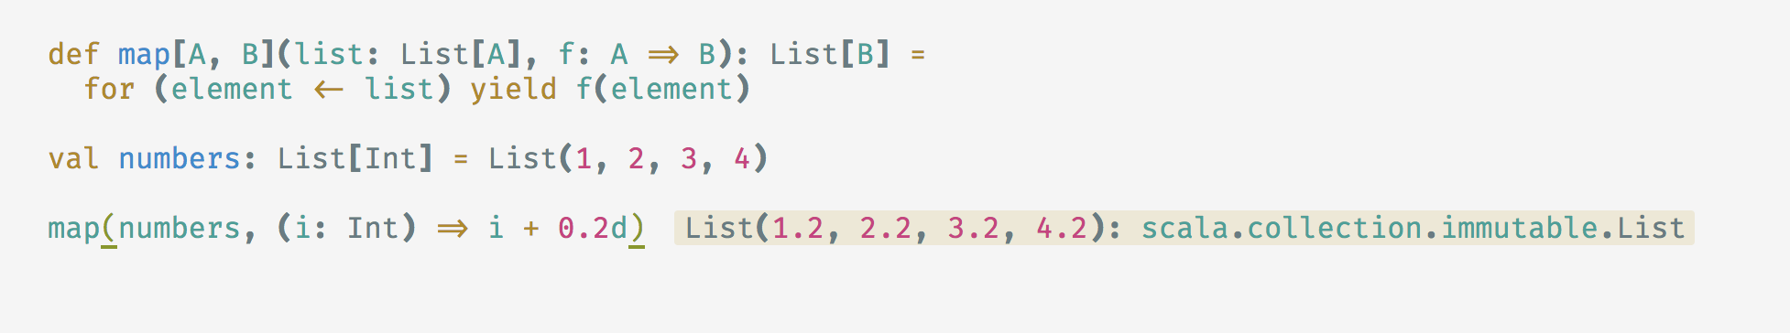
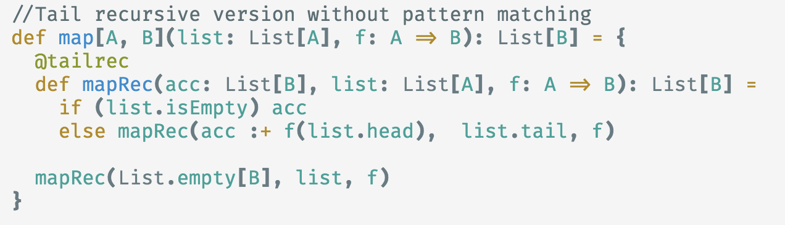
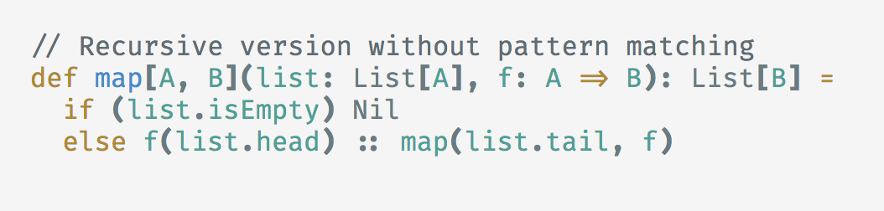
High order functions
functions that take functions as arguments or return functions
Notes:
map no es un mapa :D

Slide 20
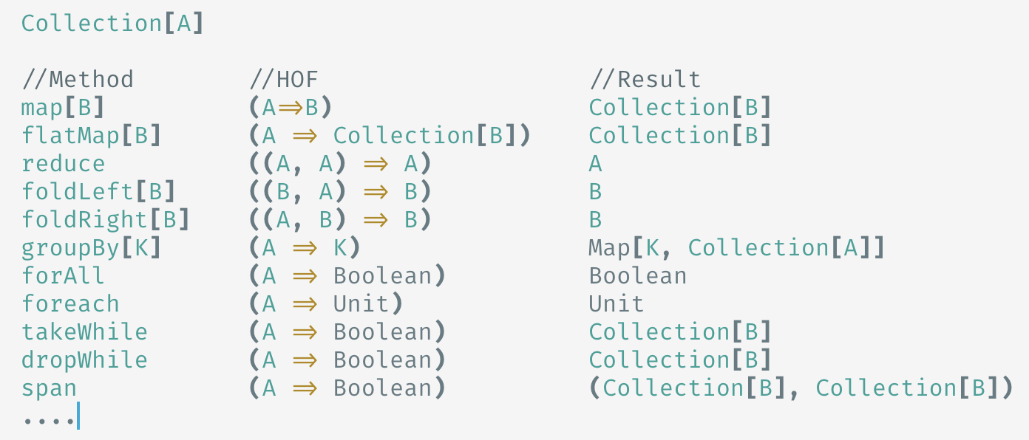
High order functions
and collections API has plenty of them out of the box...

Slide 21
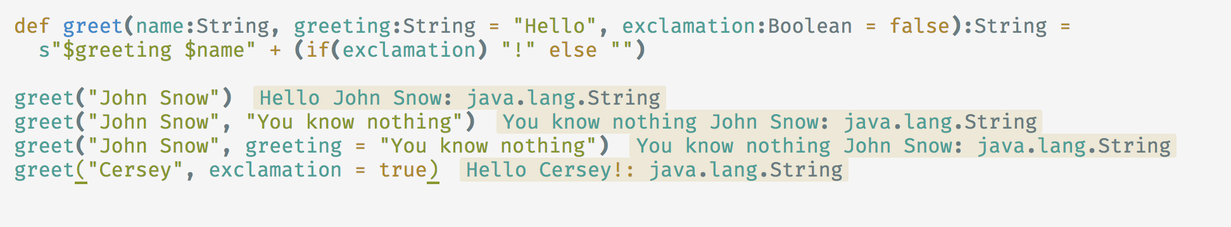
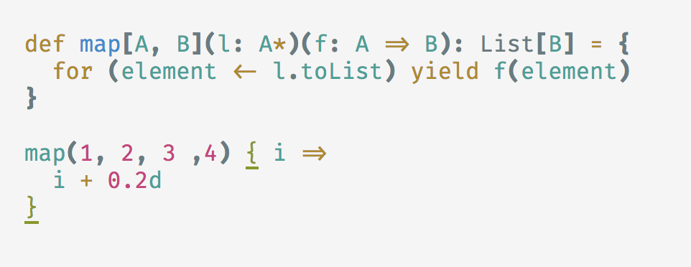
Methods are cool
Named parameters + default values
Multiple parameter lists

Slide 22
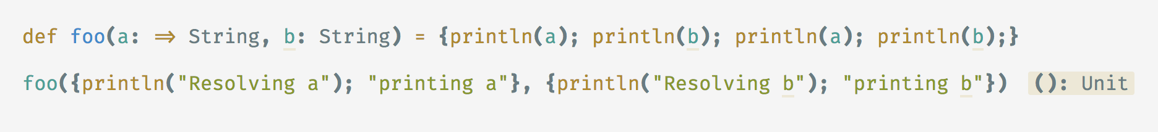
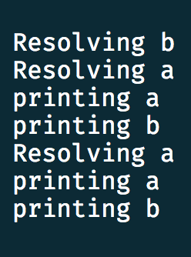
by-value vs. by-name parameters

Slide 23
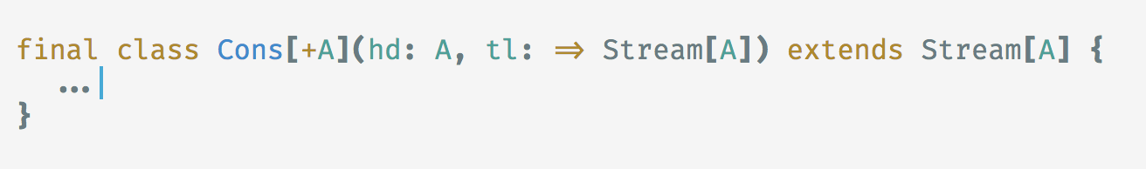
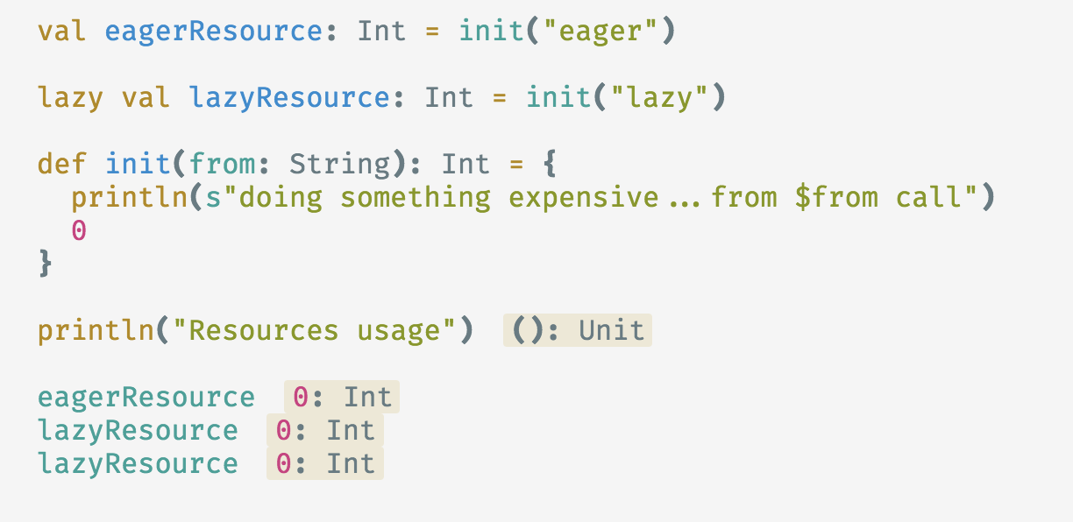
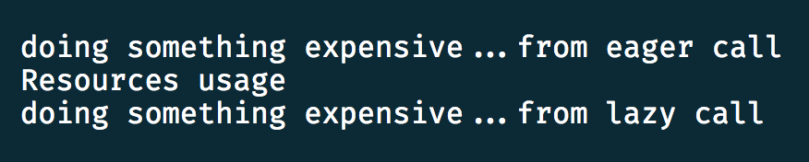
Lazy evaluation
lazy val / var

Slide 24
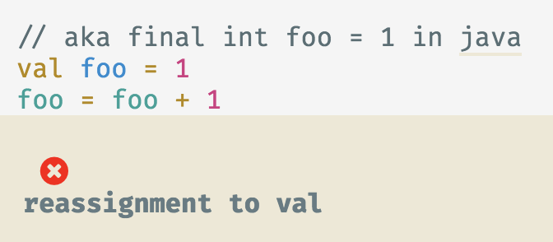
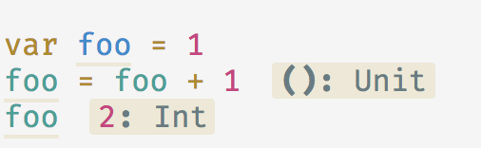
Immutability-first language
val vs var
Function parameters are vals by default
Scala Predef (object accessible in all scala compilation units) exposes immutable structures by default

Slide 25
Why immutability?
“Prefer vals, immutable objects, and methods without side effects. Reach for them first. Use vars, mutable objects, and methods with side effects when you have a specific need and justification for them.”
--programming in scala--
It’s easy to reason about the code locally
Achieve code that has fewer defects and is easier to maintain
It allows parallelism without fearing any thread safety issues (Writing mutable parallel code is hard and very error prone)

Slide 26
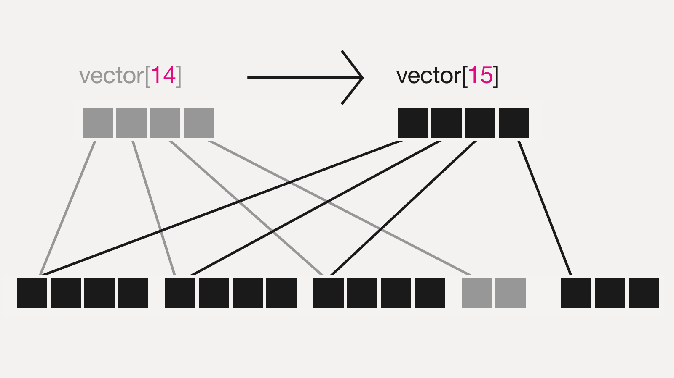
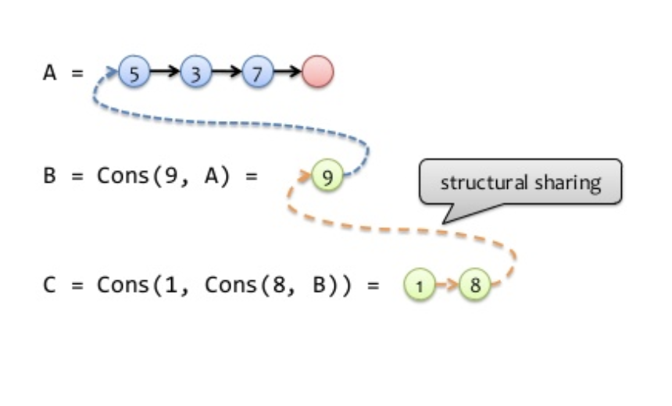
Persistent data structures support multiple versions
Structural sharing

Slide 27
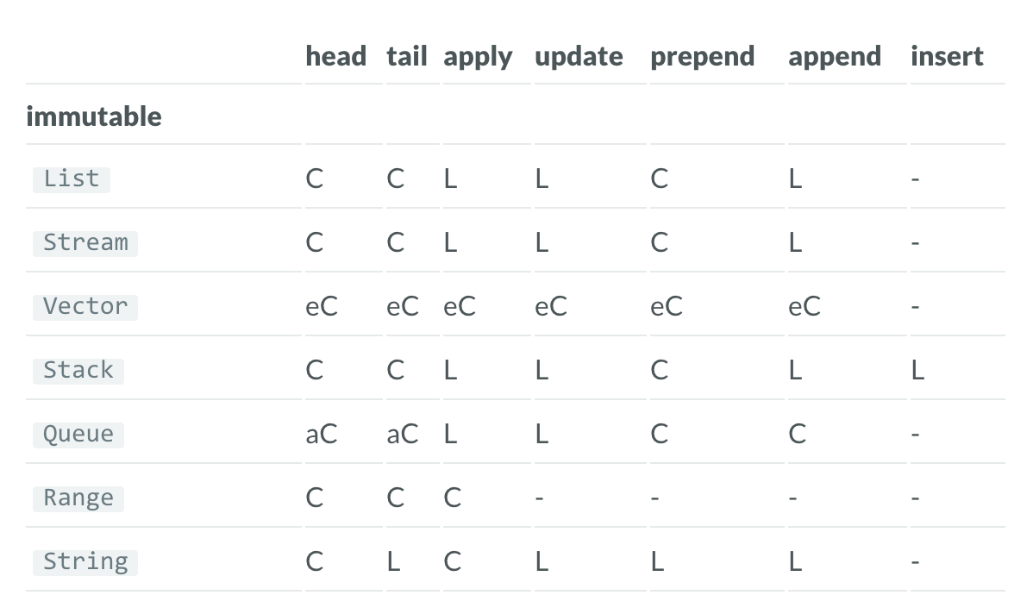
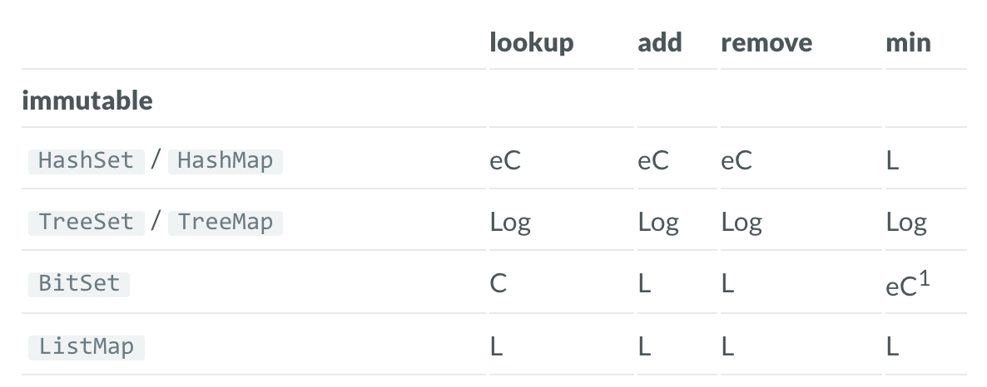
Collections performance

Slide 28
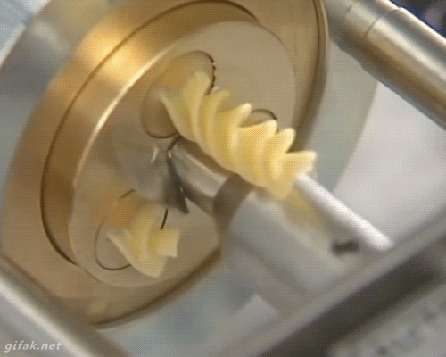

Slide 29
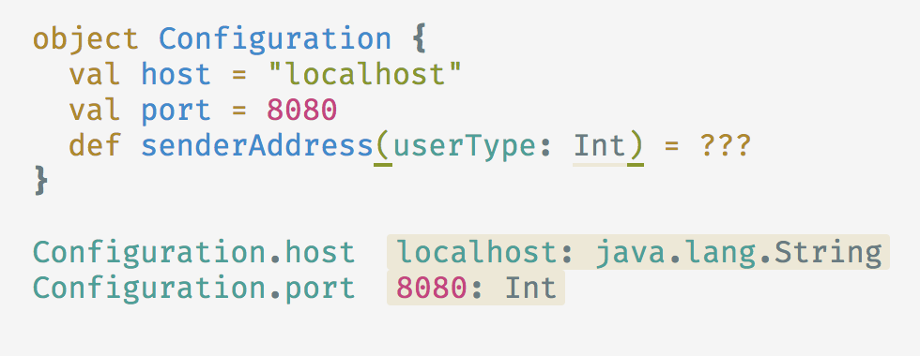
More objects...
Singleton objects
Static members
Can extend other classes or traits
scassssssssscesfgsegrge sfsedvxdvdv< ,aggzdbdrbsrehrsrjtzrmyntzfmyntdbhefagsrmfh,gjxhmfhrgseafwq

Slide 30
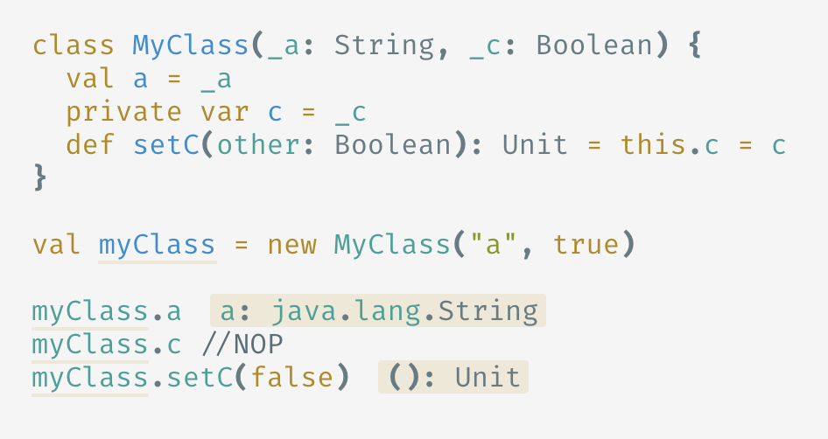
Classes

Slide 31
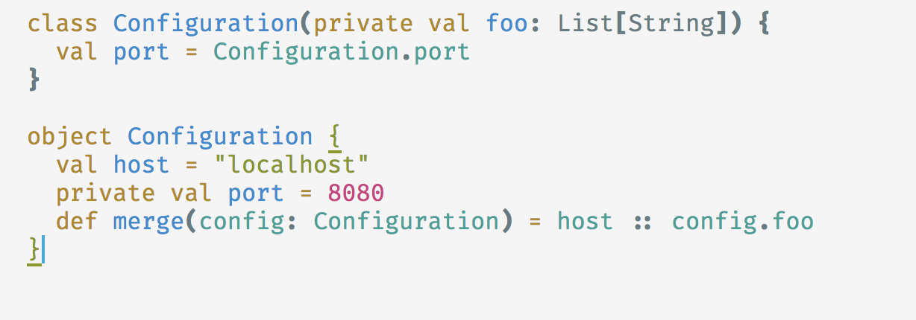
Companions forever
Same file
Share visibility
implicits related with the CC in the CO
scassssssssscesfgsegrge sfsedvxdvdv< ,aggzdbdrbsrehrsrjtzrmyntzfmyntdbhefagsrmfh,gjxhmfhrgseafwq

Slide 32
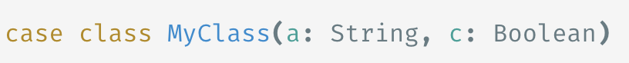
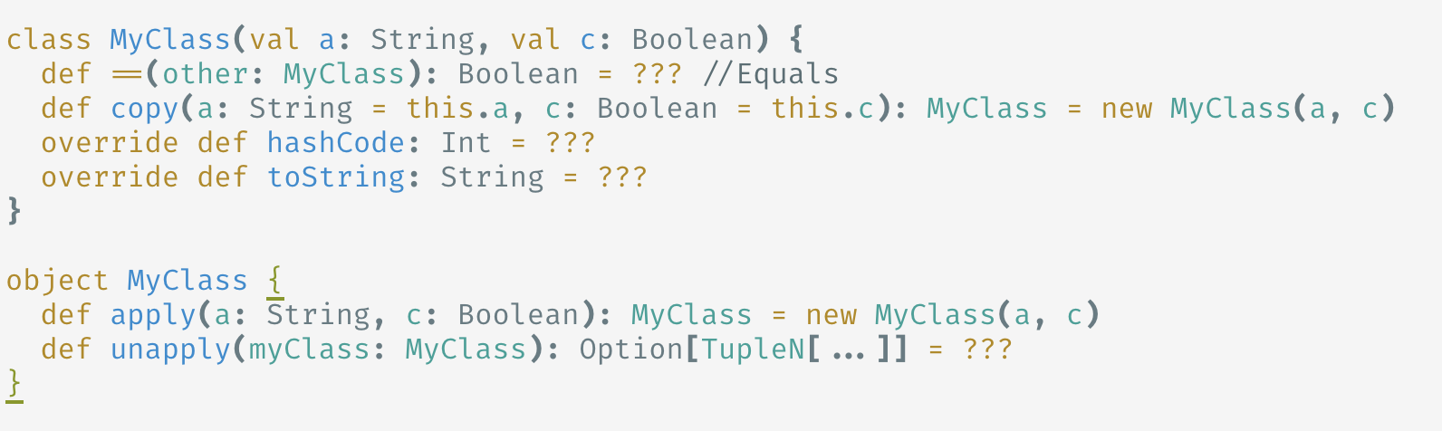
Case classes

Slide 33
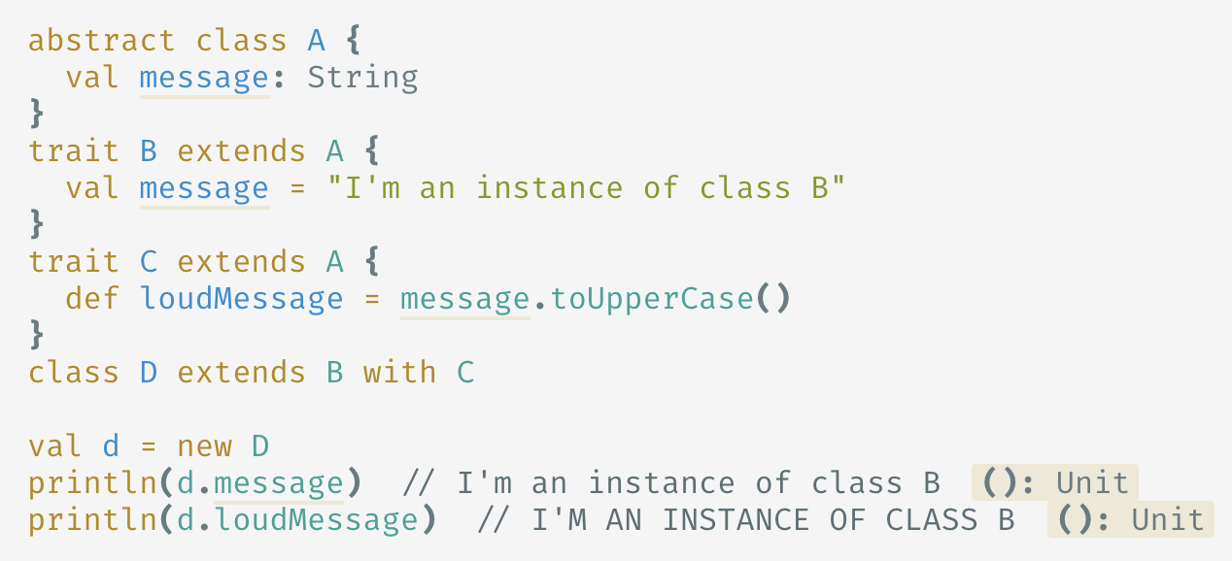
Traits
Like java 8 interfaces but with instance members
Mixins (bring functionality, not just a contract)
Can extend other classes or traits

Slide 34
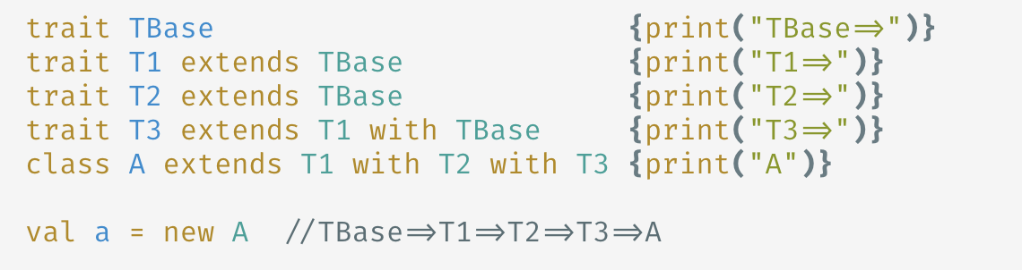
Traits (Construction)
TBase => T1 => TBase => T2 => TBase => T1 => TBase => T3 => A

Slide 35
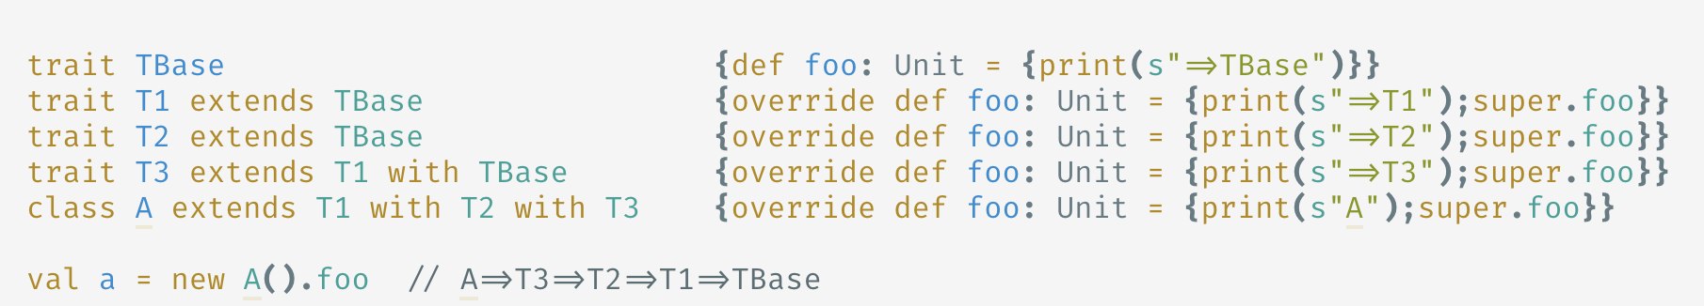
Traits (Linearization)
flatten the inheritance hierarchy graph
A => T3 => TBase => T1 => TBase => T2 => TBase => T1 => TBase

Slide 36
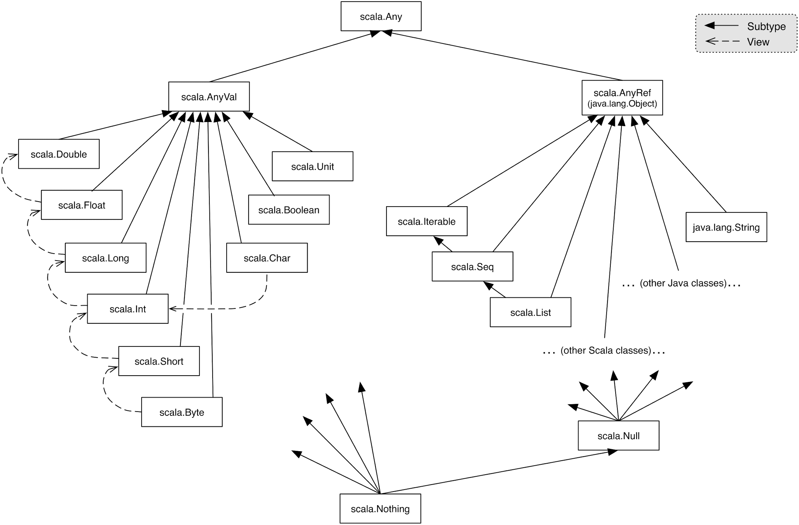
Class hierarchy

Slide 37
Pattern matching
Mechanism for checking a value against a pattern
Can match against:
Values
Variables
Types
Sequences
Tuples
RegExp
Case classes
Sometimes compiler can check for exhaustiveness
Can combine matching with guards

Slide 38
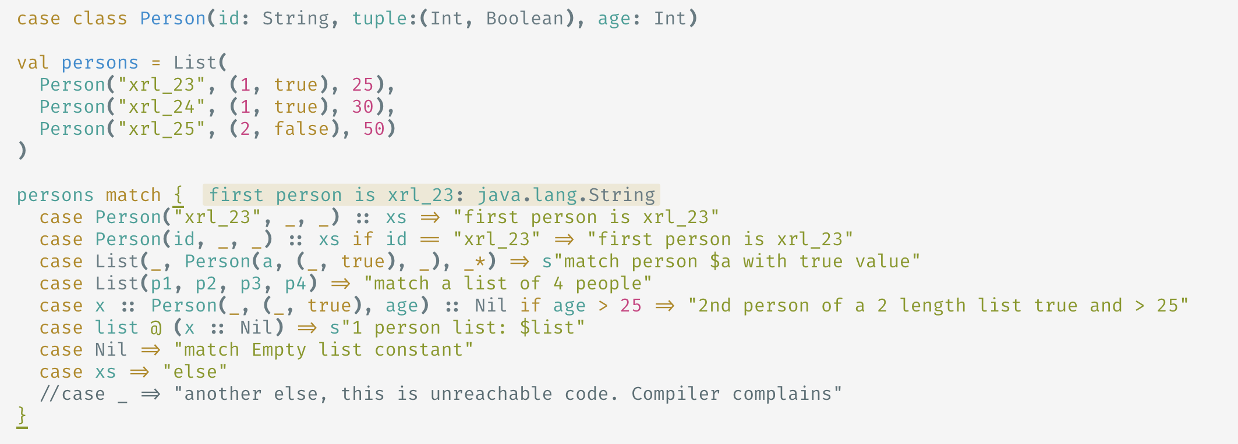
Pattern matching

Slide 39
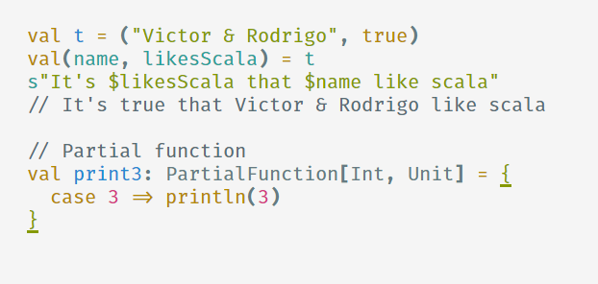
Pattern matching everywhere

Slide 40
Amazing type constructors
List[T]
Option[T]
Try[T, Throwable]
Either[A, B]
Future[T]
Types gide you. Compiler protects you from yourself!

Slide 41
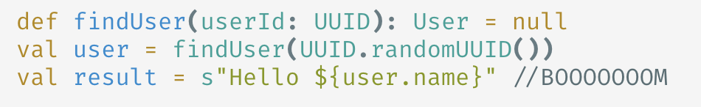
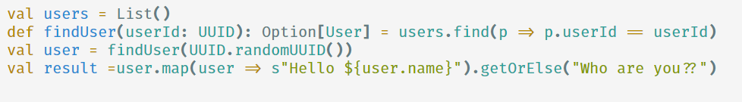
Amazing type constructors (Option)
Avoid nulls! use Options!
Don’t try this at home

Slide 42
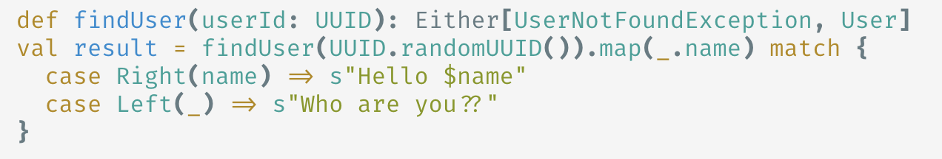
Amazing type constructors (Either)
Can be either A or B
Is right biased

Slide 43
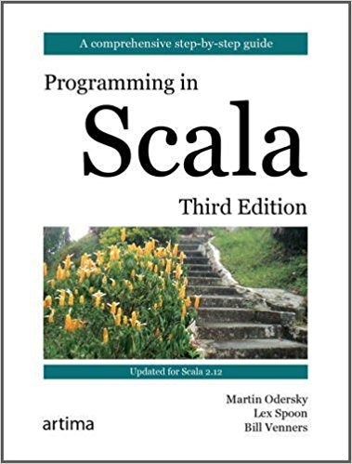
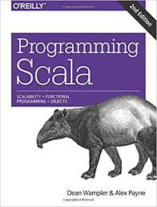
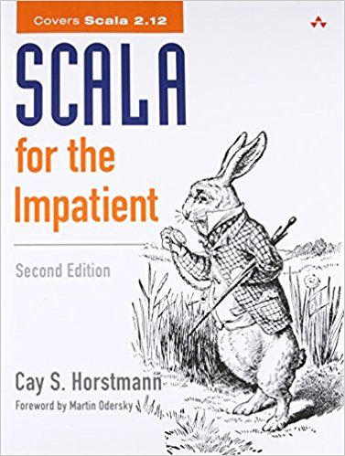

Next steps
Functional programmint principles in scala (https://es.coursera.org/learn/progfun1)
Scala exercices (https://www.scala-exercises.org/std_lib/asserts)

Slide 44

Play with the examples!
Find them at https://github.com/rodrigo-molina/intro-to-scala

Slide 45
Questions???

Slide 46
Want more???

Slide 47
Bonus track: Implicits!
Compiler doesn’t give up!!
Implicit conversion to an expected type
Sees X but needs Y then look for conversion (X=>Y)
Converting the receiver
If X doesn’t have some behaviour, then look for conversion (X=>Something that have that behaviour)
Implicit parameters
Pass implicit parameters if there are no specific ones

Slide 48

Implicit conversion (parameters)

Slide 49

Implicit conversion (methods)

Slide 50

Implicit parameters

Slide 51

Implicit classes
Extension methods with wrappers (ad-hoc polymorphism)

